Slide 1

Car Rider Pickup System for Schools
Haya Abusada, Jake Hewett, Jayden Pearson, Jack Uehlinger, Sara Vorhaben

Slide 2
Problem Background
Over 70% of students are now picked up via car, creating massive congestion.
Parents wait up to 1 hour, with lines often forming 1-2 hours before dismissal.
Queues spill onto local highways, causing traffic backups and increasing accident risks.
Inclement weather increases delays as bus and bike riders often switch to the car line.
The manual process requires 5-10 staff members daily, diverting them from educational duties.

Slide 3
Needs Statement
School pickup via the car rider line has been increasing in the US over the years leading to an increase in line length and pickup time. Now, over 70% of students are picked up from school via the car rider line. Car rider lines have become congested, posing a safety issue for both the students and other drivers. With more students attending school, car rider lines have become too slow and cause parents to wait up to over an hour in line leading to frustration. Some studies show that the car rider pick-up line starts to form 1-2 hours before school actually gets out, which leads to traffic backing up local highways and streets, and even frequent accidents. Inclement weather further slows the line, as students who ride the bus or bike to school will often be picked up by their parents in the car rider line to avoid the weather. Additionally, 5-10 staff members are required to set up and run the pickup process, diverting their time away from the education of students. An automated system is needed to streamline the pick-up process to decrease delays and safety issues.

Slide 4
Goal and Objectives
Goal
The goal of this project is to design and prototype a system that will help automate the car rider pick up process at schools. The system is built to reduce the amount of time necessary to pick up students from school.
Objectives
The system will allow parents to update their information (license plate numbers, approved adults for pickup, car rider schedules) via a website with approval from a staff member of the school.
The system will read the marker on the car (license plate, QR code, nametag) as it enters the pickup line and send the information to a server.
The server will identify the parent and child associated with the car marker, and update a display at the entrance of the pickup line to direct the car to the proper station.
The laptop at the front of the school is updated to inform the students and staff which child is being picked up, and which zone to go to.

Slide 5
Goal and Objectives - Requirements
Marketing Requirements
Make the pickup process faster for parents
The system should be easily updated
The system should be low cost
The system should be easy to use/install
Information must be validated if updated or inserted
Student safety should be ensured (information, physical, etc.)
The system should be reliable

Slide 6
Goal and Objectives - Requirements
Marketing Requirements | Engineering Requirements
1 | Pickup time should be reduced by 30% per 100 kids. The time from the car entering the view of the camera to information being displayed should be no more than 5 seconds.
4 | 7 inch (diagonal) display screen to give station and process instructions clearly.
1, 6 | Per Texas Family Code, ensure that students are referred to authorized parents 100% of the time.
6 | Private Information stored in the database should be encrypted using 128 bit encryption.
7 | Should have a stable connection from within 1 kilometer, stable power to all components.
1,6,7 | Should correctly identify/assign parents to kids 100% of the time.
3 | The costs for developing the system should not exceed $300.
2,4,5 | The system should allow parents to submit a request to the school to update information and the school should receive the request all within 1 minute.

Slide 7
Goal and Objectives - Requirements
Marketing Requirements | Engineering Requirements
4 | The system should have a modular design such that failed components can be replaced by a technician in under 15 minutes.
4,7 | The system should be mounted correctly on a tripod to ensure stability and prevent hazards. Sandbag/Weights of at least 1 pound to keep it grounded.
7 | The software will comply with the Digital Millennium Copyright Act.
2,4,5,6 | Staff should be able to access databases with provided credentials and view all parent to children links.
4,7 | The system should be able to withstand 20mph wind.
1 | Minimum 40inch (diagonal) display screen to give station and process instructions clearly inside in the pickup .
4 | The system should have a modular design such that failed components can be replaced by a technician in under 15 minutes.
4,7 | The system should be mounted correctly on a tripod to ensure stability and prevent hazards. Sandbag/Weights of at least 1 pound to keep it grounded.

Slide 8
Literature Review -
Overview
Schools use technology to reduce pickup congestion, improve safety, and streamline communication
These systems inform our design, though none use our proposed method
Existing Systems
PikMyKid – App-based digital car line; parents announce arrival, staff release students via dashboard
Beeline – Uses geofencing to detect vehicles and alert staff automatically
Car-Pool App – Geofencing and ETA alerts to stage students before arrival
iSchoolRide – GPS-based parent check-in for just-in-time student release
Kids Pick Up App – QR code scanning to verify authorized pickups
Key Takeaway
Current solutions reduce manual effort and congestion
Most still rely on parent apps, GPS, or staff scanning and verification

Slide 9
Design Constraints and Feasibility
Technical and Temporal Constraints
Maximum of 5 seconds from image capture to display update
Identification accuracy must be 100% to ensure safety and efficiency
Connection between the system parts must be reliable
Physical and Environmental
Needs to withstand outdoor elements (wind and rain)
Needs to be portable and stable with modular parts, mounting, and power supply to reduce system downtime and speed up repair and maintenance
Economic
Must cost $250 or less, necessitating cost-effective components
Feasibility
Core technology, such as Python image processing and Wi-Fi, is well documented and achievable
Main challenge will be creating a fast and efficient system within our budget

Slide 10
Evaluation of alternative solutions
Solution | Pros | Cons
Manual Pickup App (PikMyKid) | Easy to implement; low cost; reduces paperwork | Requires staff queue management; no automated vehicle identification
Integrated Dismissal System (Beeline) | Improves communication; integrates with school systems | Requires training and infrastructure; still staff-monitored
Geofencing (Car-Pool App) | Real-time arrival alerts; reduced manual check-ins | Dependent on GPS accuracy, mobile devices, and connectivity
GPS Check-In (IschoolRide) | Keeps students inside until arrival; reduces idle staging | Relies on parent app usage and accurate GPS; staff verification will still be needed
QR Codes (Kids Pick Up App) | Simple, affordable; no cellular service required | Requires staff scanning; affected by glare, weather, and visibility
All alternatives improve organization but still rely on staff actions or parent interaction, limiting full automation.

Slide 11
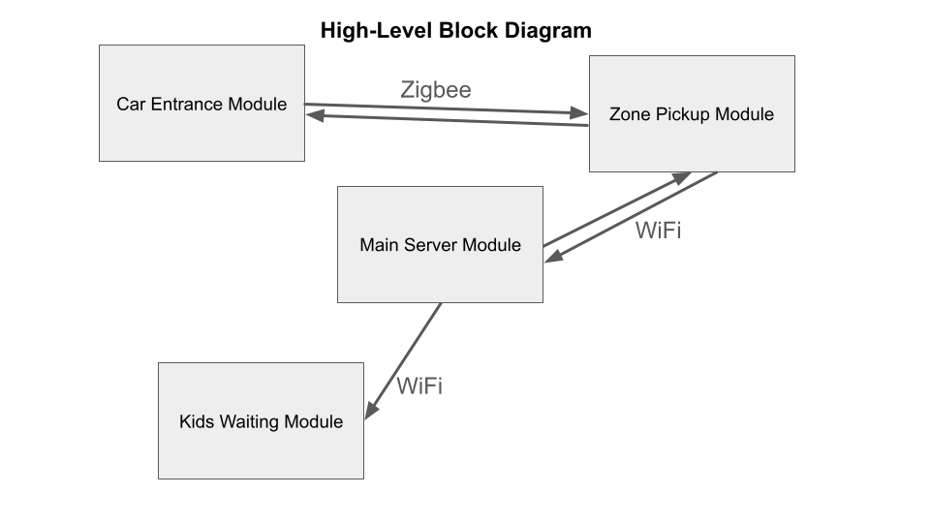
Proposed design - High-Level Block Diagram
Need 4 main modules
Car Entrance Module
Located at entrance of line
Zone Pickup Module
Located at pickup zones
Main Server Module
Located inside school’s office
Kids Waiting Module
Located at area where kids wait
to be called (gym, cafeteria, outside)
Zigbee - low power wireless mesh
network standard 0-100m (similar to Bluetooth)
More reliable than Bluetooth for small
packets of data
Avoid Bluetooth interference from passing cars
No stable WiFi at entrance
Notes:
range

Slide 12



Proposed design - High-Level Block Diagram
Car Entrance Module
Car line entrance
Car Stations
--------------------------------
Kids Waiting Module
Zone Pickup Module
Main Server Module
Notes:
range

Slide 13
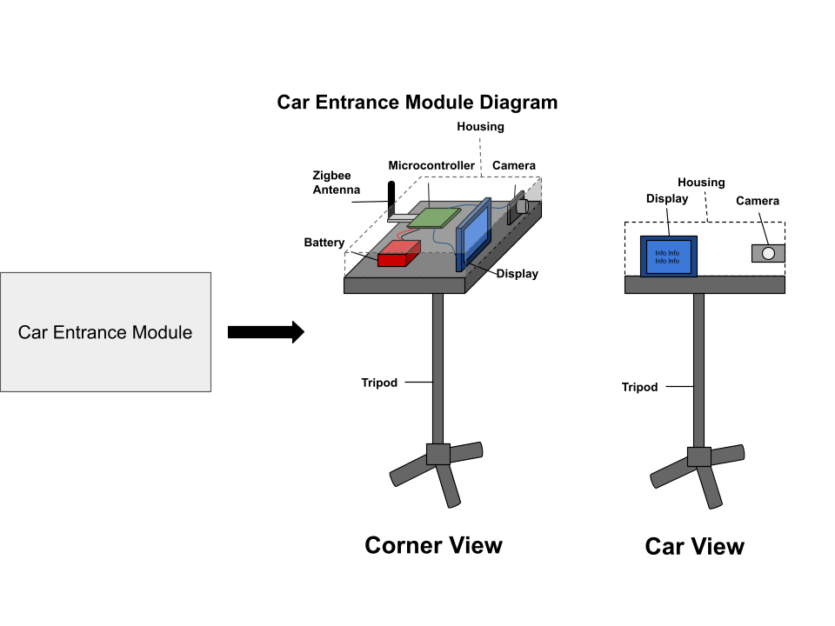
Proposed design - Car Entrance Module
Primary function is to complete license plate recognition
Camera takes frequent pictures
Processes image for license plate
Once found, send license plate number using Zigbee
Display for parents
Wait for results from server, then update display to confirm correct kid and direct parent to specific zone
3D printed housing
Protect components from direct sunlight and light rain
Example packet of info sent:
{
“event”: “license_plate_detected”,
“plate”: {
“number”: “ABC1234”,
“state”: “TX”
}
}
Example packet of info received:
{
“event”: “update_display”,
“info”: {
“name”: “John Doe”,
“zone”: “1, red”
}
}

Slide 14
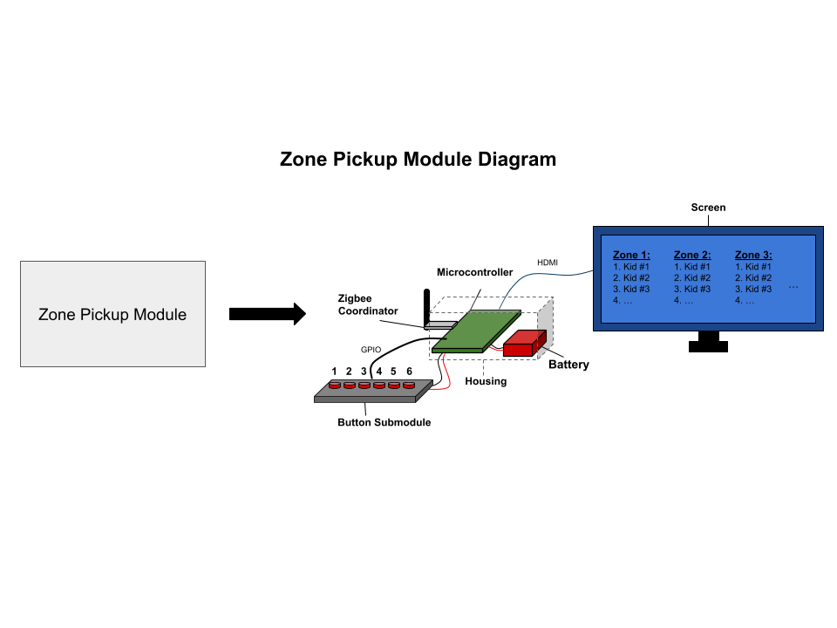
Proposed design - Zone Pickup Module
Act as a receiver for Zigbee communication - forward info to server (WiFi)
Also forward info from server to car entrance module (Zigbee)
Large screen to display website at the zones - lists of kids being picked up at each zone
Button submodule - allows staff member to press a button when a kid is picked up at a zone, one button for each zone
Removes kids name from list
3D printed housing
Block direct sunlight and light rain

Slide 15
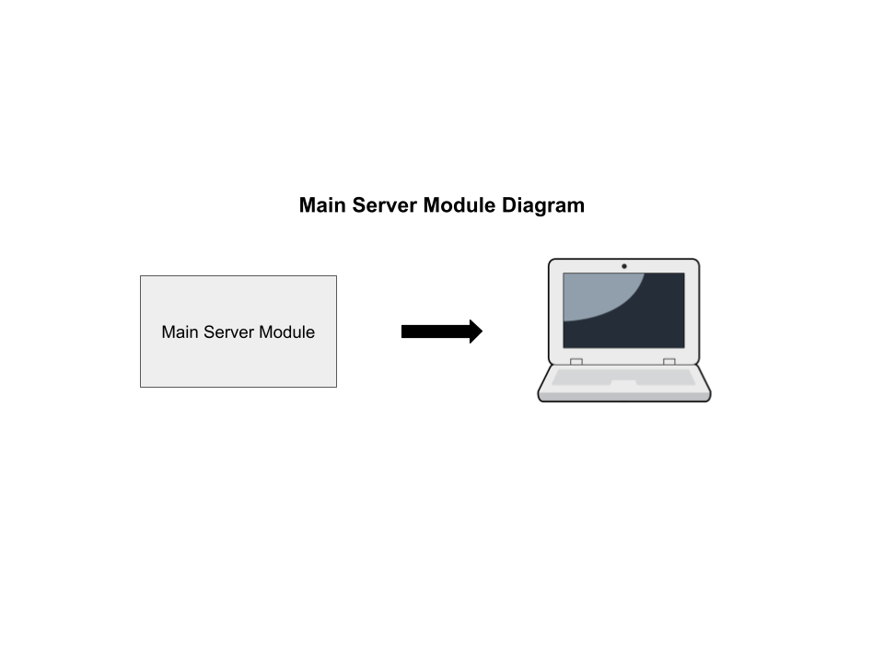
Proposed design - Main Server Module
Located in school’s office
Host a website - updated in real time
Displayed on screens in zone pickup and kids waiting modules
Connect to database that contains info about all kids parents, pickup schedule, and license plate numbers.
Query the database to find info given license plate number
Update database based on requests made by parents (once approved by admin)
Send updates to display in car entrance module
After querying database
Server ←→ WiFi ←→ Zone Pickup Module ←→ Zigbee ←→ Car Entrance Module

Slide 16
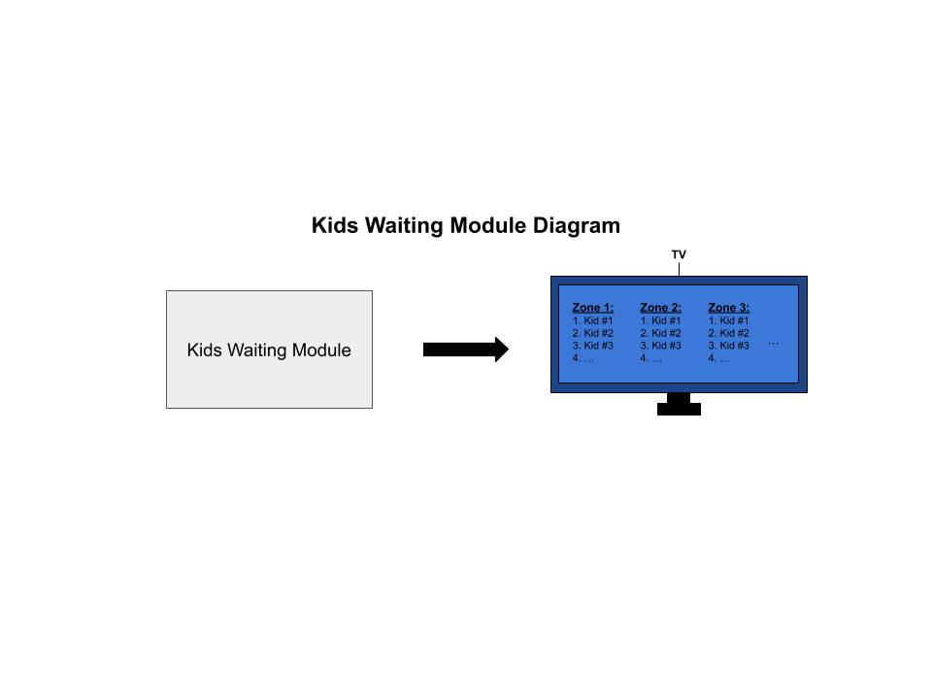
Proposed design - Kids Waiting Module
Large TV screen where kids are gathered to wait (gym, cafeteria, outside)
Display website to inform staff and kids who is being picked up, and what zone to go to

Slide 17
Approach for design validation
Small, foundational testing first
Verify connectivity to web server and database
Display text found by the camera directly to the screen it is connected to
Ping router from the car entrance module to verify connectivity
QUERY database to ensure proper initialization
System testing comes next
Packets should be sent to the database, should return student names
Screens directing drivers and students should update in no more than 5 seconds
Web server flags incoming requests to alter database to admin page
Notes:
Improve specs with respect to requirements

Slide 18
Economic analysis and budget
Economic Viability:
National Center for Education: There are 70,055 Public Pre-Kindergarten, Elementary and Middle Schools
Each school has to have a pickup system
Could also be used in Daycares and Private Schools
Save Parents & Teachers Time
Allow them to spend time in more productive ways
Production costs for items and the 3D casing would decrease if ordered and produced in bulk

Slide 19
Economic analysis and budget
Sustainability:
Raspberry Pi, Camera and Zigbee are all available from multiple vendors
Standard software frameworks are used to ensure long-term support
Limited Customer maintenance:
Charging of rechargeable batteries
Yearly website database setup
Software updates

Slide 20
Economic analysis and budget
Manufacturability:
Camera alignment/height needs to be correct to ensure licence plate can be read
Casing of Camera designed to withstand wind and rain
Modular Design allows for easy replacement of broken components
In the event that the license plate doesn’t match, we have a separate spot for pickup
End-to-End is testable as well as component based testing
Compliant with student privacy regulations

Slide 21
Economic analysis and budget
Car Entrance Module
Total* (without including components provided): $107
Total: $325
Car Entrance Module | Amount Needed | Cost per Unit | Total Amount
Tripod | 1 | $22 | $22
Raspberry Pi | 1 | $75 | $75*
Raspberry Pi Camera | 1 | $55 | $55*
Camera Lens | 1 | $50 | $50*
Zigbee Antenna | 1 | $27 | $27
Rechargeable Battery | 1 | $40 | $40
7-inch display | 1 | $38 | $38*
Mounting Screws | ~20 | $8 (600 pcs) | $8
Wires | ~5 | $10 (240 pcs) | $10
Total* (without including components provided) | $107
Total Cost | $325

Slide 22
Economic analysis and budget
Zone Pickup Module
Total* (without including components provided): $82.50
Total: $272.50
Zone Pickup Module | Amount Needed | Cost per Unit | Total Amount
Raspberry Pi | 1 | $75 | $75*
Zigbee Antenna | 1 | $27 | $27
Rechargeable Battery | 1 | $40 | $40
27-inch monitor | 1 | $97 | $97*
Push Buttons | 6 (depending on # of zones) | $11.50 (24 pcs) | $11.50
Mounting Screws | ~20 | $8 (600 pcs) | $8*
Wires | ~15 | $10 (240 pcs) | $10*
HDMI Cord | 1 | $4 | $4
Total* (without including components provided) | $82.50
Total Cost | $272.50

Slide 23
Economic analysis and budget
Main Server Module
Assuming server is hosted on a computer used by the school
Total: $0
Main Server Module | Amount Needed | Cost per Unit | Total Amount
Total Cost | $0
Kids Waiting Module
Total* (without including components provided): $0
Total: $180
Main Server Module | Amount Needed | Cost per Unit | Total Amount
55-inch TV | 1 | $180 | $180*
Total* (without including components provided) | $0
Total Cost | $180

Slide 24
Economic analysis and budget
Total budget without any components provided:
Total budget with provided components:
Car Entrance Module | $325
Zone Pickup Module | $272.50
Main Server Module | $0
Kids Waiting Module | $180
Total | $777.50
Car Entrance Module | $107*
Zone Pickup Module | $82.50*
Main Server Module | $0
Kids Waiting Module | $0*
Total* | $189.50
Note*: 3D printed prototypes not included, FEDC grants $75 allotment for fabrication

Slide 25
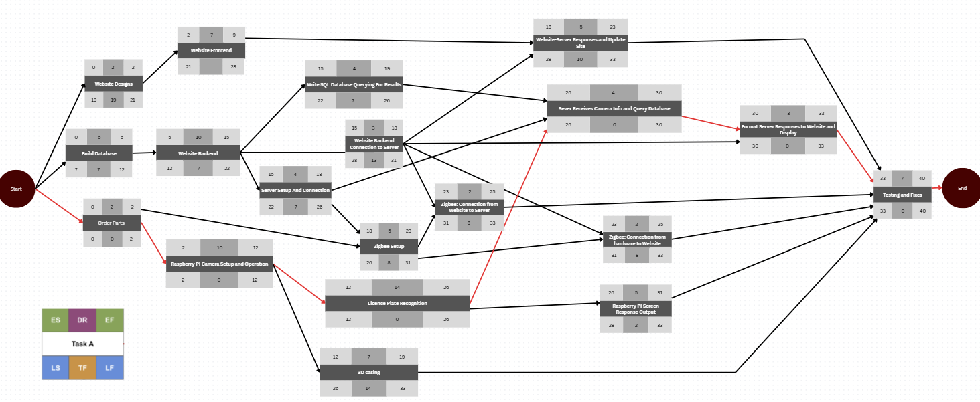
Schedule of tasks - Pert Chart
Sara
Critical Path: 45 days

Slide 26
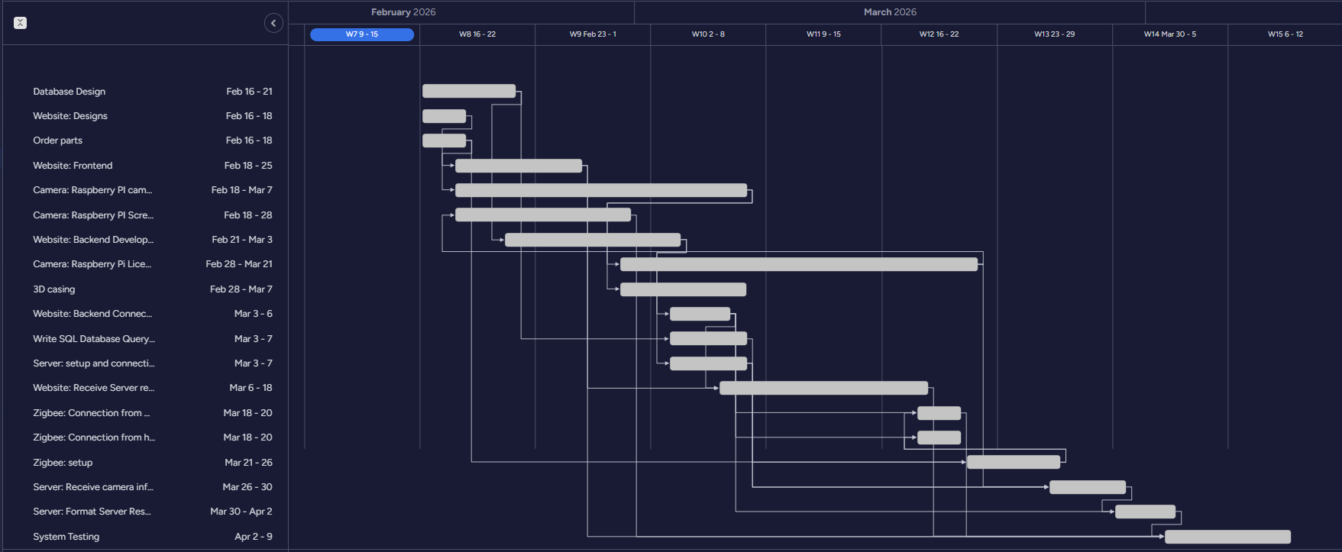
Schedule of tasks - Gantt Chart

Slide 27
Schedule of tasks
Name | Start Date | End date | Time | Task description:
Order parts | 2/16/2026 | 2/18/2026 | 2 | Order all remaining parts
Website: Designs | 2/16/2026 | 2/18/2026 | 2 | Create wireframes for Parent Portal Page, Login Screen, Admin Dashboard, and Kids Pickup Status Screen, and get group approval of designs
Build Database | 2/16/2026 | 2/21/2026 | 5 | Create database schema, basic CRUD queries and set up authentication-related database endpoints
Website: Frontend | 2/18/2026 | 2/25/2026 | 7 | Implement approved designs with responsive layouts
Camera: Raspberry PI camera setup and operation | 2/18/2026 | 2/28/2026 | 10 | Install Raspberry Pi OS, enable camera interface, install required libraries and test image capture functionality
Website: Backend Development | 2/21/2026 | 3/3/2026 | 10 | Set up backend framework, connect it to the database, implement authentication and authorization logic, validate user input, and implement basic logging

Slide 28
Schedule of tasks
Name | Start Date | End date | Time | Task description:
Camera: Raspberry Pi Licence Recognition | 2/28/2026 | 3/21/2026 | 14 | Develop license plate recognition system using Raspberry Pi camera
3D casing | 2/28/2026 | 3/7/2026 | 7 | Design casing for Raspberry Pi camera system
Server: setup and connection | 3/3/2026 | 3/7/2026 | 4 | Configure server environment and set environment variables, and ensure secure database connectivity
Write SQL Database Querying For Results | 3/3/2026 | 3/7/2026 | 4 | Write SQL Queries for pickup to match license plate numbers to authorized parents
Website: Backend Connection to Server | 3/3/2026 | 3/6/2026 | 3 | Deploy backend application to server environment
Zigbee: setup | 3/6/2026 | 3/18/2026 | 5 | Install Zigbee coordinator and modules

Slide 29
Schedule of tasks
Name | Start Date | End date | Time | Task description:
Zigbee: Connection from hardware to the Website | 3/18/2026 | 3/20/2026 | 2 | Configure server to update Website when hardware sends plate
Camera: Raspberry PI Screen Response Output | 3/21/2026 | 3/26/2026 | 5 | Make the screen show green when recognized license plate number is verified & handle error or unrecognized plate cases
Server: Receive camera info and query the database | 3/26/2026 | 3/30/2026 | 4 | Implement server-side endpoint to receive license plate data from Raspberry Pi, validate input, and query database for matching parent/student
Server: Format Server Responses to Website and Display | 3/30/2026 | 4/2/2026 | 3 | Send verification results to both classroom display system and website frontend
System testing | 4/2/2026 | 4/9/2026 | 7 | Test end-to-end functionality of entire system

Slide 30

Project management and teamwork
Haya
Hardware Design
OCR Design
Jake
Web Applications
OCR Design
Jack
Team Leader
Systems Design
monday.com will be used for project management. It will track dependencies and division of labor, as well as provide a timeline for the project
Jayden
Hardware Design
Systems Design
Sara
Database Design
Web applications
Everyone
Software Engineering
Documentation/ Reports
Testing

Slide 31
Societal, safety and environmental analysis
Societal:
Parents spend less time waiting in line
Teachers spend less time managing pickup and more in classroom
Kids are less likely to get agitated/distracted leading to less problems for staff/parents
The secure system ensures that students are released to the correct parents
Safety:
Ensure that kids end up with the correct parent
No kid is lost in the system or placed incorrectly
Ensure that kids aren’t put in dangerous situations (ex running in the road)
Environmental:
Reduction in vehicle idling

Slide 32
Questions?
Thanks for listening!

